Slide 1
CSCI 3022
Dr. Zachary Mullen Hello and Welcome!
Intro

Slide 2
The plan
Course Overview
Software Data Science
More Logistics
Intro

Slide 3
Syllabus Material
The course Canvas page will house:
Course Overview
The course syllabus and schedule
Annotated lectures posted after completion of the lecture
Homework Assignments and their turn-ins locations
Grades
Links to In-Class Notebooks, Data sets, and course Piazza page (register!)
Whatever else is necessary
Piazza: https://piazza.com/colorado/fall2019/csci3022
Ask questions in Q & A forum (and answer other students’ questions!)
Discuss work, but do not post solutions/vital code
Send private messages to faculty instead of email (keeps things organized)
Intro

Slide 4
Learning Goals
Course Overview
At the end of this class, students should be able to:
load a data set into Python, clean and munge the data, perform exploratory data analysis, and report on patterns and correlations in the data,
compute and interpret various measures of central tendency, such as the mean, median, and mode; and measures of dispersion, such as variance, and standard deviation,
write the axioms of probability theory, prove basic theorems of probability theory, and apply those theorems to solve ”real-world” problems involving chance events,
estimate population parameters of interest by calculating point and interval estimates from a sample/data,
perform statistical hypothesis tests,
construct and perform diagnostics on simple linear, multilinear, and logistic regression models to make predictions and inferences about data, and
construct basic data visualizations in Python and organize analyses, findings, and recommendations into easily interpretable reports in Jupyter Notebooks.
Intro

Slide 5
”Other” Courses
Course Overview
This course functions as a survey-level course for material sometimes found in:
Introduction to Data Science and Programming
Applied Probability (APPM 3570)
Introduction to Mathematical Statistics (APPM 4520)
Statistical Modeling/Regression (APPM 4590)
Intro

Slide 6

Coding Overview
Software
We will use Python 3 and in particular Numpy and Pandas
Lot’s of great data science libraries and decent plotting
We’ll exclusively work in Jupyter Notebooks. We strongly recommend you install local copy
If not, you can use Microsoft Azure or Google Colab notebooks
Often work on problems in groups in class
Bring a laptop or have a buddy with a laptop
Intro

Slide 7
Python
Software
What:
Python is free high-level programming language built for flexibility and simple syntax. It is commonly used in statistical computing and graphics.
Why we’re using it:
It’s widely used - especially in industry - free, and has a healthy repository of packages.
Common Syntax
Function Syntax: Functions use indents to determine the stopping point after a colon. The function def myfunction(x): ends after the indenting stops. Indexing: Python is 0-indexed, and uses square brackets. For an n x m matrix named mydata, mydata[3,2] accesses the entry in row 4 and column . Comments: # comment
Favorite Reference: Official Documentation
Intro

Slide 8
Jupyter
Software
What:
Jupyter notebook is free web application to combine running live code and visualizations.
Why we’re using it:
Statistics is inherently interdisciplinary, and communication of clear results is paramount. The notebook environment encourages replicabile results and a clear workflow.
Common Syntax
Cells: The notebook is divided into cells. For our purpose, expository material will be done in Markdown cells with L^{A}T_{E}Xcompatibility.
Computational work will be done in Python 3 code cells, which may also generate plots, histograms, tables, and other output.
Formatting: # (with varying numbers of # signs) can be used to create section headers in markdown cells.
Comments: % comment
Intro

Slide 9
L^{A}T_{E}X
Software
What:
L^{A}T_{E}Xis a typesetting software with a particular emphasis on mathematics, including matrices, greek letters, etc.
Why we’re using it:
Microsoft Equation Editor is a pain. It’s included in Jupyter for Markdown cells.
Common Syntax
Function Syntax: Functions use curly brackets; ”\textit{arg}” would italicize the argument
Math mode: inputting ”$ arg $” will apply mathematical typesetting to the argument.
Comments: % comment
Favorite Reference: https://en.wikibooks.org/wiki/LaTeX
Intro

Slide 10
Learning New Software
Software
There are 3 major tools to use in learning new software:
Google searches, often directed to sites like stackexchange.
Pirating similar code found in (1.) or from course materials, etc. (Don’t Copy/Paste! Write from pseudo code, and cite any sources if you use them!)
Official documentation
Use them all often, and don’t hesitate to
1. Ask your instructor or peers for ideas on how to write specific routines, or for their syntax knowledge. Piazza is made for exactly this sort of thing!
Intro

Slide 11
What is Data Science?
Data Science
Making the invisible visible
Recovering insights/trends hiding within the data
Using data to answer interesting questions
Catch-all: using data to understand the world around us
Warning Label: we will do a lot of the “science” side of “data science”
Probability! Statistics! Math!
Intro

Slide 12
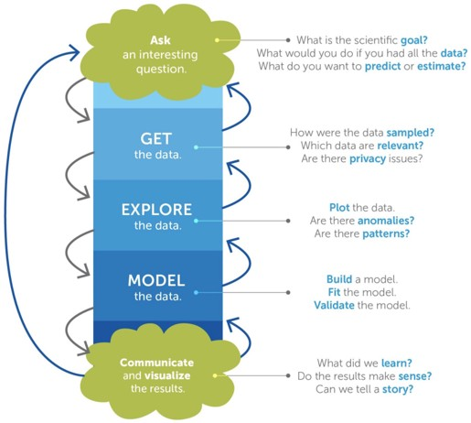
Science!
Data Science
Hypothesis
Observations
Analysis
Conclusions
Refinements (repeat!)
Intro

Slide 13
Data Science
Foundations
Realms | Topics
Probability Statistical Inference Optimization and Calculus Linear Algebra CS | EDA, null models and hypotheses, Markov models averages, regression models, MLEs model fitting, computational shortcuts Many many matrices... data structures, rapid estimations, simula- tion
Intro

Slide 14
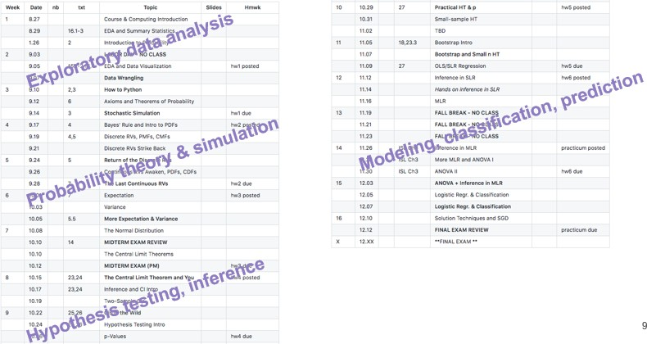
Data Science
The Plan
Intro

Slide 15
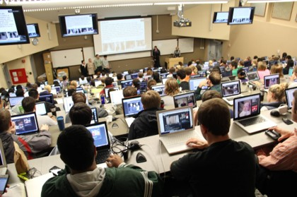
Laptops
More Logistics
“Results showed that students who used laptops in class spent considerable time multitasking and that the laptop use posed a significant distraction to both users and fellow students. Most importantly, the level of laptop use was negatively related to several measures of student learning, including self-reported understanding of course material and overall course performance.”
http://www.sciencedirect.com/science/article/pii/S0360131506001436
Also: http://journals.sagepub.com/doi/pdf/10.1177/0956797616677314
And: http://www.sciencedirect.com/science/article/pii/S0272775716303454
Intro

Slide 16
Evaluations
More Logistics
Workload:
e (35%) Homework assignments ( every 2 weeks, lowest dropped, late days)
e (20%) Midterm exam
e (20%) Final exam (cumulative)
e (10%) Practicum 1 ( midterm)
e (10%) Practicum 2 ( final)
e (5%) Quizlets (Canvas)
e ≥ 55% exam average required to earn a C- or higher in the class Let me know about any special needs in a timely manner Read the syllabus! More details can be found there regarding course policies (see: Late days!)
Intro

Slide 17
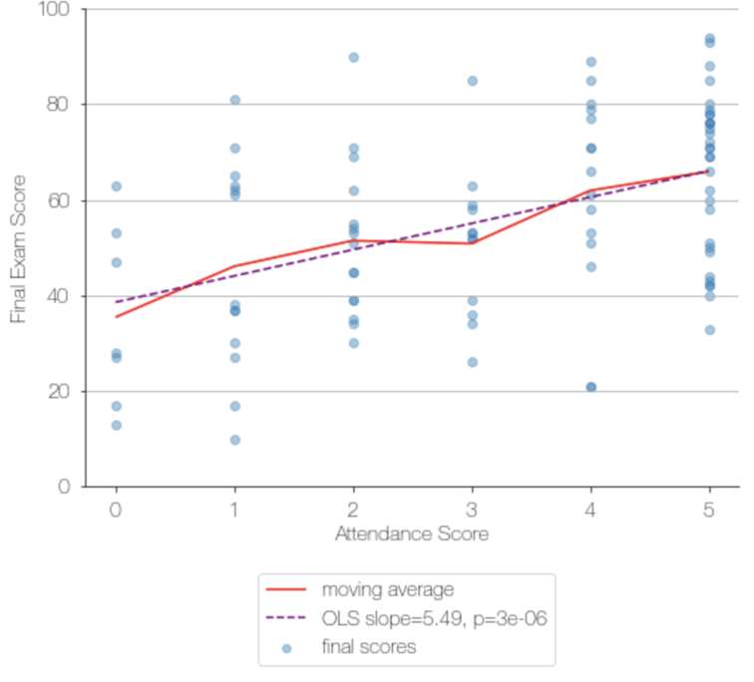
More Logistics
Attend!
Correlation...
Intro

Slide 18
If at first you don’t succeed...
More Logistics
When you’re asking for help, be sure to explain. . .
what you’re trying to do
what you think should happen
what you get instead (copy/pastes or screenshots work well)
what all you have tried
if you haven’t tried anything, try something first
Intro

Slide 19
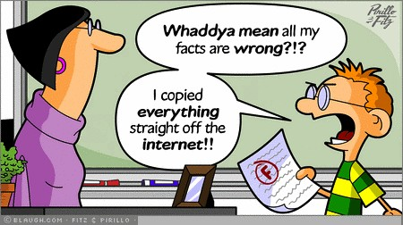
Academic Integrity
More Logistics
See the CU Academic Integrity Policy for more details. Here are some highlights. “Examples of cheating include: copying the work of another student during an examination or other academic exercise (includes computer programming)”
“Examples of plagiarism include: . . . copying information from computer-based sources”
Intro

Slide 20
Integrity Examples
More Logistics
Example 1: For an assignment, Chris searches the internet for relevant codes and copy-pastes them into his Jupyter Notebook. He properly cites the source of the codes.
Example 2: For an assignment, Maciej and Felix work together to figure out how to implement the codes, but each works on their own computer and develops their own software.
Example 3: For an assignment, Rhonda has a plan for how to implement an algorithm, but isn’t sure how to manipulate a Python list in a particular way that she needs to. She searches the internet, finds a fix, and implements it in her code without copying it.
Intro

Slide 21

Text
More Logistics
A Modern Introduction to Probability and Statistics (MIPS)
by Dekking (et al.)
International, older, and PDF editions will work: just make sure to match any section numbers that changed.
Free PDF edition through CU (CU network, or VPN): https://www.springer.com/us/ book/9781852338961
Additional reading will be linked to the course calendar as needed
Intro

Slide 22
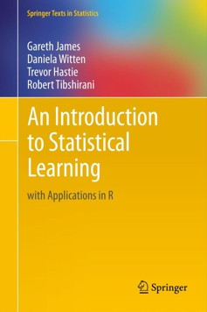
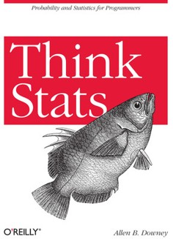
Other Texts
More Logistics
Think Stats by Downey (“TS”)
An Introduction to Statistical Learning (“ISL”)
Intro

Slide 23
Moving Forward
More Logistics
Let’s get to work!
e Get out your laptop, or – better yet – partner up with someone with a laptop and work together!
Numpy and Pandas tutorial
nb00
nb01 notebook
e Before next class:
Make sure you can access the Canvas page and read the syllabus
Set up some way to back up your work
Install Anaconda (or other reliable Jupyter notebook method)
Review and complete Numpy/Pandas tutorial
Explore nb01
Intro

